Slide 1
The Evolution of Programming Languages
A timeline and “family tree”
from 1804 to the present

Slide 2
About Me
James Classen (nessalc on Slack)
Textron Aviation
Verification Engineer
Programming:
Python
C#
JavaScript
Whatever else seems relevant or useful at the time 🙂
Notes:
James Classen (nessalc on Slack)
Textron Aviation
Verification Engineer
Programming:
Python
C#
JavaScript
Whatever else seems relevant or useful at the time 🙂

Slide 3
Assumptions for this Presentation
Wikipedia was my primary source, so errors are their fault.
If I don’t cover your favorite language, it’s not necessarily because it’s not important, or that I didn’t research it, but 219 years is a lot, so I’m glossing over a lot. Including the last 30 years.
Notes:
Wikipedia was my primary source for the information in this presentation, as I didn’t have the time to research these topics in nearly as much depth as they deserve. As such, the “firsts” I mention are the first instances I could find, and are not necessarily the firsts in reality.
This topic could be expanded to a multi-volume academic work, and if no one is working on it yet, they should start soon while a handful of the pioneers are still around to tell their tale.

Slide 4
The Beginnings
Jacquard Loom - 1804
Babbage Difference Engine - 1822
Babbage Analytical Engine - 1837
Begriffsschrift - 1879
Plankalkül - 1948
Notes:
Jacquard Loom - 1804 (while based on earlier inventions in 1725, 1728, and 1740, all involving holes punched in paper or cardstock of some sort, Jacquard’s allowed patterns of arbitrary complexity and size, and also a “programming” device (similar to a typewriter) to allow a user to more easily create the pattern)
Babbage Difference Engine - 1822 (polynomial solutions for numbers up to 20 digits in length for up to 6th order polynomials, used also for trigonometric functions, logarithms using Newton’s method)
Babbage Analytical Engine - 1837 (generalized difference engine, Lovelace programmed for this, Note G described a method for computing Bernoulli numbers, considered among the first computer programs)
Begriffsschrift - 1879 (formal language for describing algorithms)
Plankalkül - 1948 (first high-level language specifically designed for computers, first formal language to include branches and loops, never went beyond conceptual stage)

Slide 5
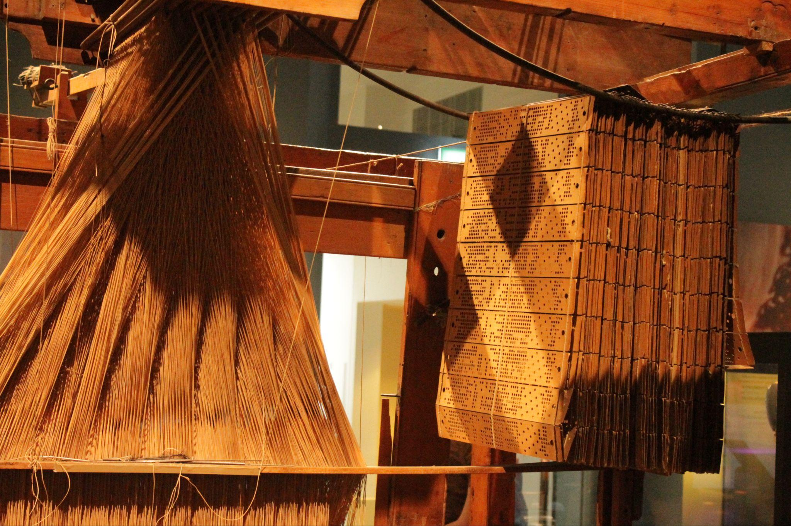

Slide 6
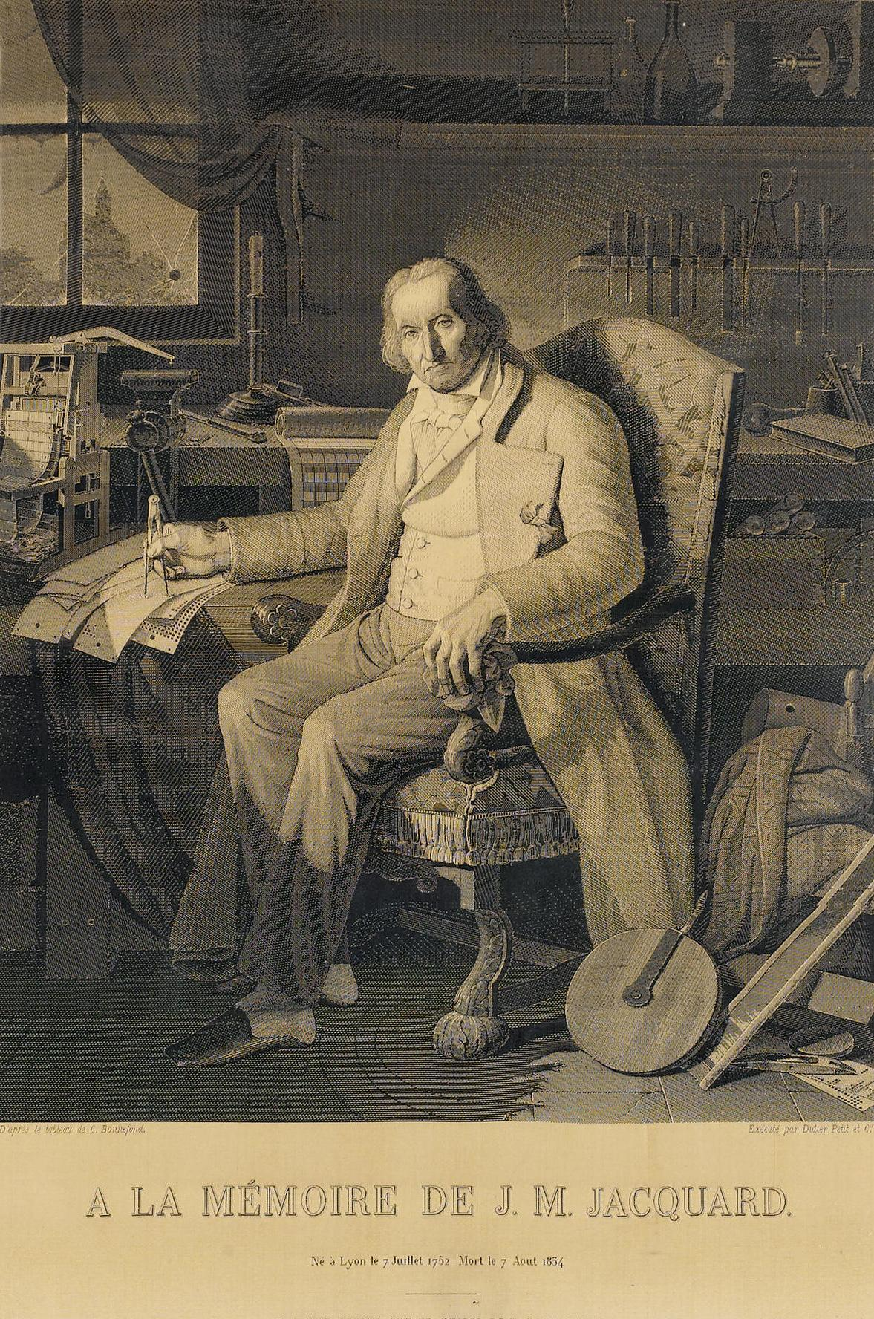
Notes:
Required 24000 punched cards to create

Slide 7
Things pick up speed
IBM Card-Programmed Electronic Calculator - 1949
Short Code - 1950
A-0, A-1, A-2, A-3 (ARITH-MATIC), AT-3 (MATH-MATIC), B-0 (FLOW-MATIC)
Speedcode - 1953
Laning and Zierler system, a.k.a. George - 1954
Fortran - 1954
LISP - 1956
Notes:
IBM Card-Programmed Electronic Calculator - 1949 (context-dependent punch cards)
Short Code - 1950 (first high-level language for an electronic computer, UNIVAC, interpreted language)
A-0, A-1, A-2, A-3 (ARITH-MATIC), AT-3 (MATH-MATIC), B-0 (FLOW-MATIC) - 1951-1955 (by Grace Murray Hopper for UNIVAC)
Speedcode - 1953 (first high-level language for an IBM computer, first to natively support floating point numbers)
Laning and Zierler system, a.k.a. George - 1954 (first? compiled language)
Fortran - 1954 (granddaddy of compiled and interpreted languages, ancestor with COBOL, of most modern languages, discussed later)
LISP - 1956 (all parentheses, all the time, first designed for Turing-completeness, first tree data structures, first automatic storage management/garbage collection, dynamic typing, recursion, and REPL; first bootstrapped language)

Slide 8
ALGOL - 1958
COBOL - 1959
APL - 1962
Simula - 1962
BASIC - 1963
Notes:
ALGOL - 1958 (no reserved words, arbitrary array bounds)
COBOL - 1959 (first designed to run on multiple computers specifically for business functions, designed by committee, prose syntax, over 300 reserved words, programs structured in “sections”, “paragraphs”, and “sentences”, scope termination is a period)
APL - 1962 (named after the book “A Programming Language”, uses special symbols for concise code, required modification of IBM Selectric typewriters, operated on a multidimensional array, used as an educational tool until 1968)
Simula - 1962 (considered the first object-oriented language)
BASIC - 1963 (Beginners' All-purpose Symbolic Instruction Code)

Slide 9
We finally find a way to make a lot of transistors on a chip!
MUMPS - 1966
BCPL - 1967
Pascal - 1970
Thompson shell - 1971
Smalltalk - 1972
C - 1972
SQL - 1972
Notes:
We finally find a way to make a lot of transistors on a chip!
MUMPS - 1966 (Massachusetts General Hospital Utility Multi-Programming System, among the first languages with an integrated key-value database language, and remains the predominant database for electronic health records in the US; also used by TD Ameritrade, Bank of England, and Barclays)
BCPL - 1967 (Basic Combined Programming Language, introduced using curly braces to delimit code blocks)
Pascal - 1970 (essentially a fork of ALGOL, allowed defining dynamic and recursive data structures, strong typing on all objects, nested procedure definitions to any depth)
Thompson shell - 1971 (first Unix shell, introduced input/output redirection, pipes)
Smalltalk - 1972 (purely object-oriented language created for educational use, pioneered new aspects of JIT compilation)
C - 1972 (Ken Thompson cut down BCPL syntax and added features he liked from ALGOL to create B, which he would use to help Ritchie further develop the PDP-11 port of Unix; Ritchie wanted to improve B to utilize new features of the PDP-11, which eventually became C)
SQL - 1972 (introduced accessing many records with a single command, and how to reach a record with or without an index)

Slide 10
AWK - 1977
MATLAB - 1978
VisiCalc - 1978
dBase - 1979
Ada - 1981
LabVIEW/G - 1986
HyperTalk - 1987
Notes:
AWK - 1977 (though designed for one-line programs, and to manipulate numbers and strings, is a fully Turing-complete language)
MATLAB - 1978 (initially developed as an interactive matrix calculator for Cleve Moler’s PhD thesis, he began developing it for his students after becoming a professor)
VisiCalc - 1978 (first spreadsheet, for Apple II, allowed owners of Microsoft BASIC to write additional features like trig functions for use in VisiCalc)
dBase - 1979 (initially developed to win a JPL office football pool by processing statistics from newspapers, called it “Vulcan”; sold to Ashton-Tate who renamed it dBase)
Ada - 1981 (extremely strong typing, designed under contract to supersede 450+ languages used by DoD, and to prefer compiler errors over runtime errors)
LabVIEW/G - 1986 (data availability paradigm, graphical programming drawing “wires” between functional blocks)
HyperTalk - 1987 (interpreted scripts, repeats, conditionals, event handling)

Slide 11
Perl - 1987
Haskell - 1990
Python - 1991
Java - 1995
PHP - 1995
Notes:
Perl - 1987 (Larry Wall’s Swiss Army chainsaw, influenced heavily by AWK and sed)
Haskell - 1990 (type classes, monadic IO)
Python - 1991 (designed as a successor to teaching/prototyping language ABC with exception handling and compatibility with Amoeba OS)
Java - 1995 (class-based, object-oriented, write-once, run-anywhere, with JVM and JIT)
PHP - 1995 (general purpose scripting language for web development, not designed, but grew organically: Lerdorf noting in retrospect: "I don't know how to stop it, there was never any intent to write a programming language [...] I have absolutely no idea how to write a programming language, I just kept adding the next logical step on the way.")

Slide 12
C# - 2000
Scratch - 2002
Rust - 2010
Julia - 2012
Notes:
C# - 2000 (designed as a “simple, modern, general-purpose, object-oriented language” and was partly modeled on Java. Generics, lambda expressions, named optional arguments, string interpolation, even readonly class members weren’t added until much, much later)
Scratch - 2002 (block-based visual programming language as an educational tool)
Rust - 2010 (built for speed and memory safety without a garbage collector)
Julia 2012 (designed for scientific computing focusing on performance, can be interpreted or compiled, )

Slide 13
The Family Tree
It’s impossible to cover every language. There are simply too many. But here are the relationships between 145 of them.

Slide 14
